Slide 1
Luke 8:4-21
(English Standard Version)

Slide 2
⁴ And when a great crowd was gathering and people from town after town came to him, he said in a parable, ⁵ “A sower went out to sow his seed. And as he sowed, some fell along the path and was trampled underfoot, and the birds of the air devoured it. ⁶ And some fell on the rock, and as it grew up, it withered away, because it had no moisture. ⁷ And some fell among thorns, and the thorns grew up with it and choked it. ⁸ And some fell into good soil and grew and yielded a hundredfold.” As he said these things, he called out, “He who has ears to hear, let him hear.”

Slide 3
⁹ And when his disciples asked him what this parable meant, ¹⁰ he said, “To you it has been given to know the secrets of the kingdom of God, but for others they are in parables, so that ‘seeing they may not see, and hearing they may not understand.’ ¹¹ Now the parable is this: The seed is the word of God. ¹² The ones along the path are those who have heard; then the devil comes and takes away the word from their hearts, so that they may not believe and be saved. ¹³ And the ones on the rock are those who, when they hear the word, receive it with joy. But these have no root; they believe for a while, and in time of testing fall away. ¹⁴ And as for what fell among the thorns, they are those who hear, but as they go on their way they are choked by the cares and riches and pleasures of life, and their fruit does not mature. ¹⁵ As for that in the good soil, they are those who, hearing the word, hold it fast in an honest and good heart, and bear fruit with patience.

Slide 4
¹⁶ “No one after lighting a lamp covers it with a jar or puts it under a bed, but puts it on a stand, so that those who enter may see the light. ¹⁷ For nothing is hidden that will not be made manifest, nor is anything secret that will not be known and come to light. ¹⁸ Take care then how you hear, for to the one who has, more will be given, and from the one who has not, even what he thinks that he has will be taken away.”
¹⁹ Then his mother and his brothers came to him, but they could not reach him because of the crowd. ²⁰ And he was told, “Your mother and your brothers are standing outside, desiring to see you.” ²¹ But he answered them, “My mother and my brothers are those who hear the word of God and do it.”

Slide 5
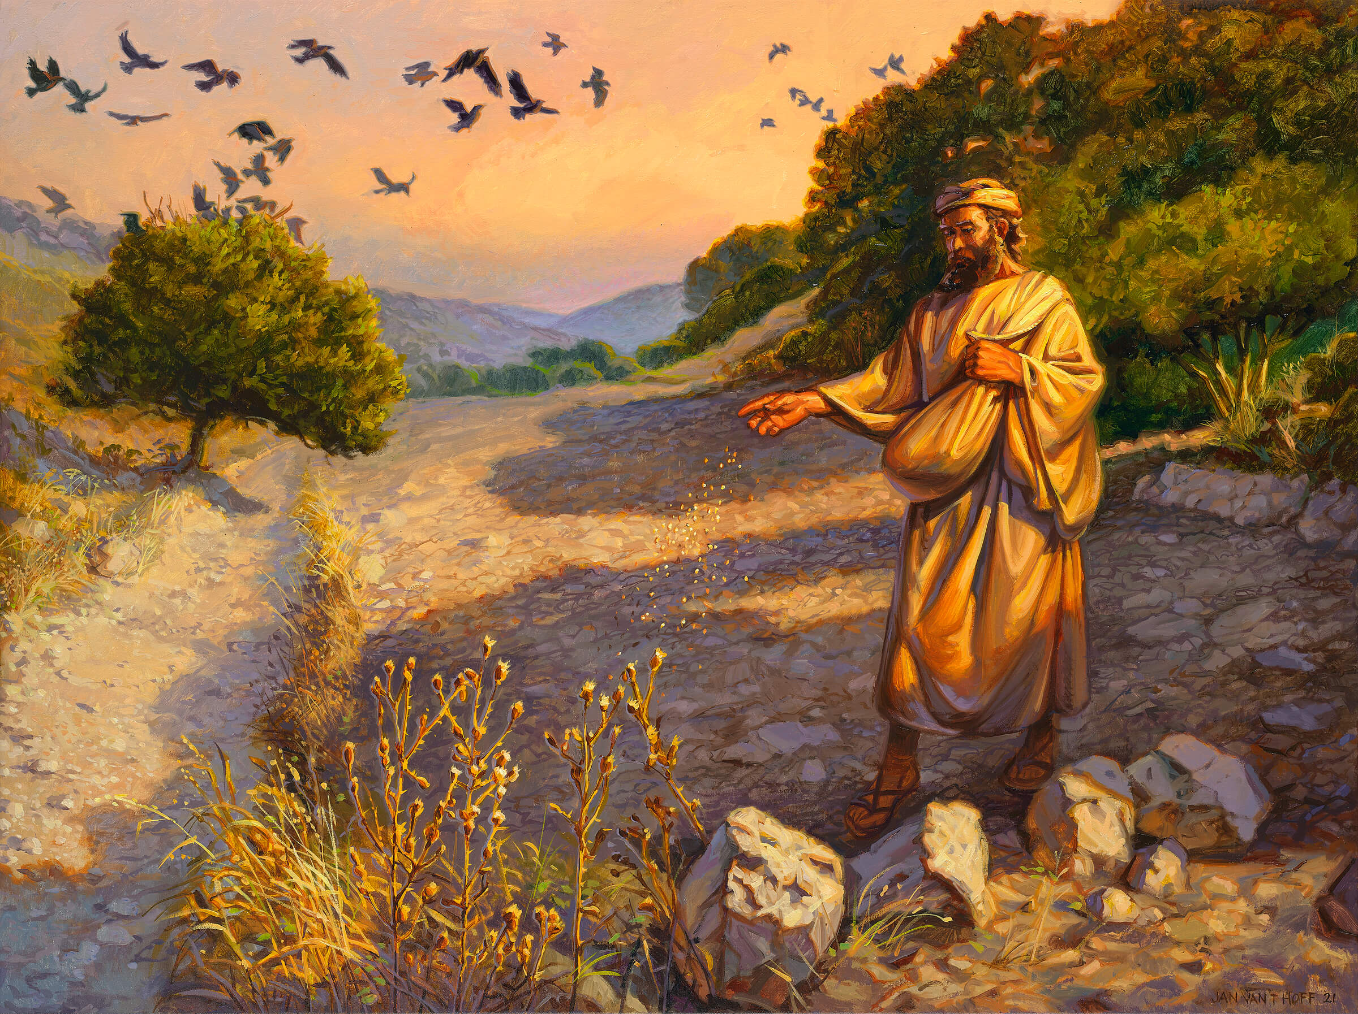

Slide 6
Saved to be hearers and doers of God’s word, clinging to Jesus (enduring)
and clinging to His word, right through to the end.
There is only one soil-type a Disciple of Jesus should aspire to be (good soil)
A farmer plants seed for it to grow through to “physiological maturity” (to the harvest)
Purpose of Parables: Insiders will understand while outsiders hear but do not understand.
Those who are resistant to God’s word will not understand; nor seek understanding
This whole section is about HEARING and what we do with what we hear.
Seed on the Path: Walked over; Devil snatches away
God’s precious word is despised
When the Word of God is proclaimed, there is a spiritual battle for the souls of those who hear
Seed on the Rock: Only a little soil – no moisture – Shrivels up – doesn’t make it to maturity
Willingly come to faith, but only for a while.
Persecutions (cost of Discipleship) cause them to abandon relationship with Jesus
Among Thorns: The more vigorous weeds strangle the crop – doesn’t make it to maturity
Anxieties, riches, quest for luxuries and decadence do not co-exist well with faith.
Faith choked by desires for these things will not carry through to completion.
Good Soil: Made fruit – yield 100 fold. Emphasis is on fruition (coming to completion)
Hold to the word of God through to completion.
Honest heart / good heart
Endurance – stick it out to the end

Slide 7
Saved to be hearers and doers of God’s word, clinging to Jesus (enduring)
and clinging to His word, right through to the end.
There is only one soil-type a Disciple of Jesus should aspire to be (good soil)
A farmer plants seed for it to grow through to “physiological maturity” (to the harvest)
Seed on the Path: Walked over; Devil snatches away
God’s precious word is despised
When the Word of God is proclaimed, there is a spiritual battle for the souls of those who hear
Seed on the Rock: Only a little soil – no moisture – Shrivels up – doesn’t make it to maturity
Willingly come to faith, but only for a while.
Persecutions (cost of Discipleship) cause them to abandon relationship with Jesus
Among Thorns: The more vigorous weeds strangle the crop – doesn’t make it to maturity
Anxieties, riches, quest for luxuries and decadence do not co-exist well with faith.
Faith choked by desires for these things will not carry through to completion.
Good Soil: Made fruit – yield 100 fold. Emphasis is on fruition (coming to completion)
Hold to the word of God through to completion.
Honest heart / good heart
Endurance – stick it out to the end
This whole section is about HEARING and what we do with what we hear.
God’s Word is a lamp that illuminates how to be saved and live in God’s righteousness
To ignore God’s Word (put the lamp in a jar) is like the 3 failed soil types
“My mother and my brothers are those who hear the word of God and do it.”
Those who are on the inside, hear the word of God and do it

